Slide 1
Free Your Feels
A Youth Mental Health Awareness Campaign

Slide 2
What Are The Campaign’s Goals?
Speak.
Listen.
Connect.
FREE YOUR FEELS
02

Slide 3
Why Do You Need Free Your Feels?
Consider the following:
How many youth/students are referred to counselors for mental health concerns?
Has your community experienced the suicide of a young person?
Do your students and youth express feelings of being overwhelmed?
Have you noticed young people isolating themselves?
FREE YOUR FEELS
03

Slide 4
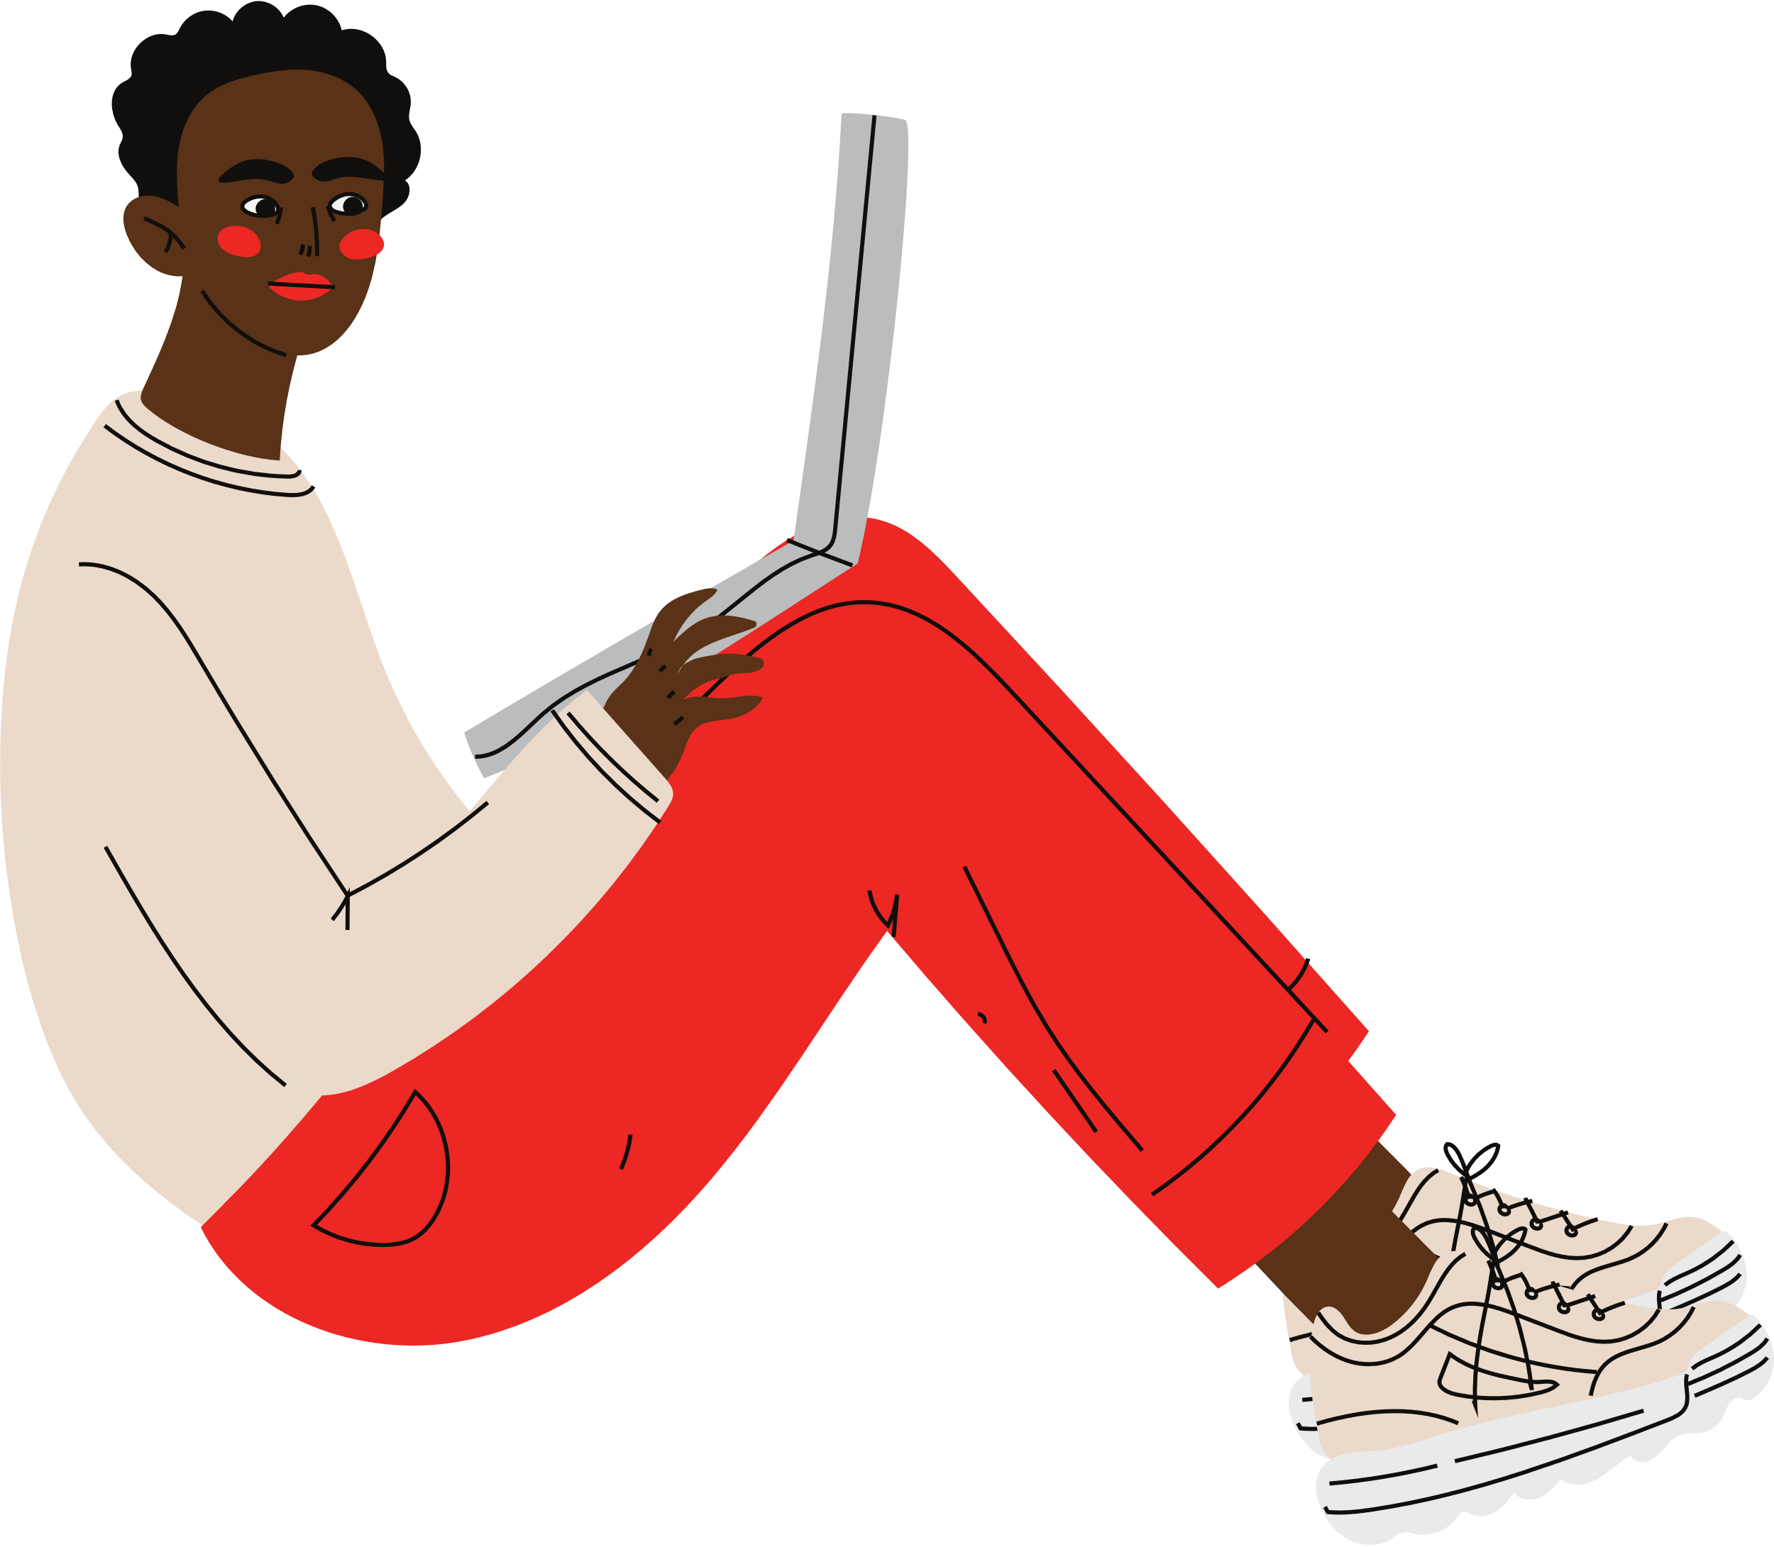
The Process
Key Stakeholder & Community Meetings
Incorporating Youth Voice
Collection of Resources & Messages
Bridging resources & the community
FREE YOUR FEELS
05

Slide 5
Community Organizations and State Agencies
FREE YOUR FEELS
06

Slide 6
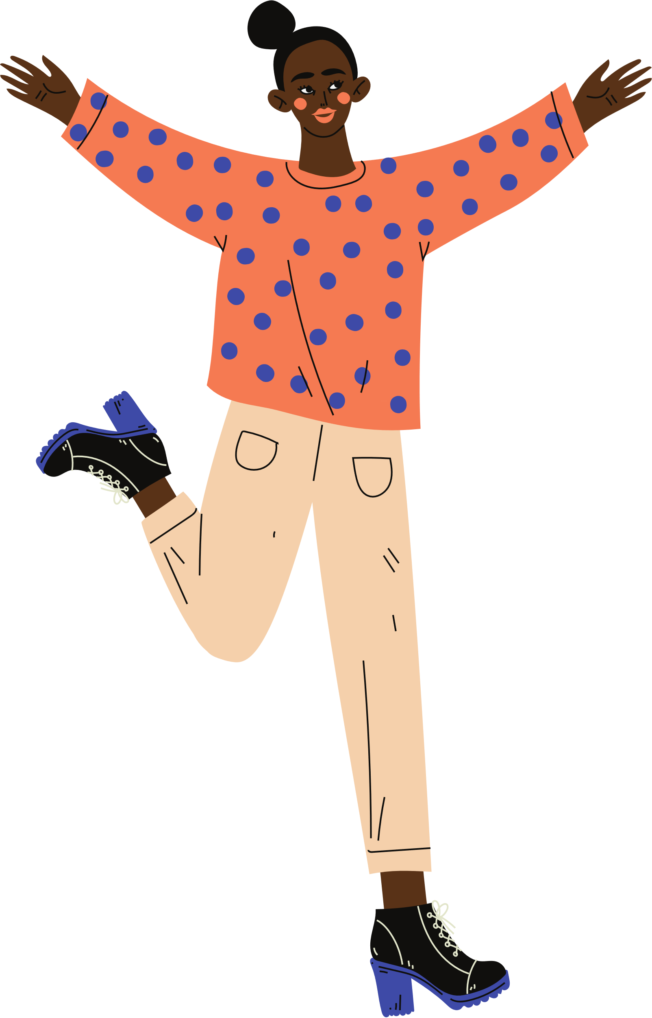
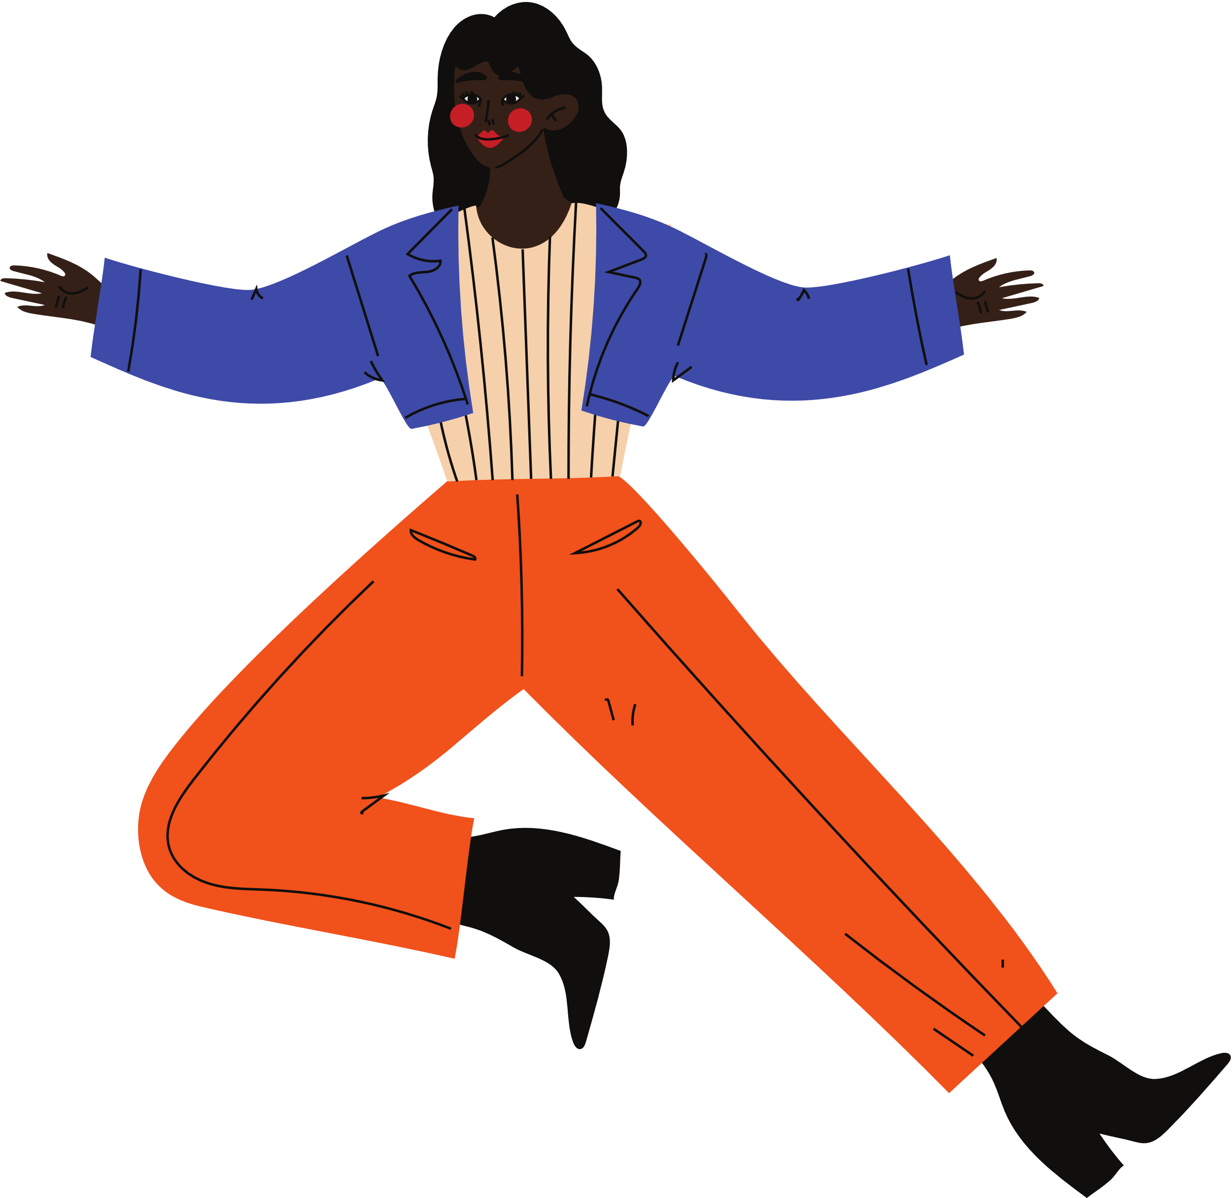
This is what we have been looking for, one place to send all of our parents and students to receive resources we try to tell them about. It’s different when you have somewhere to send them that’s at their fingertips.
— GA School Counselor Community Champions
FREE YOUR FEELS
07

Slide 7
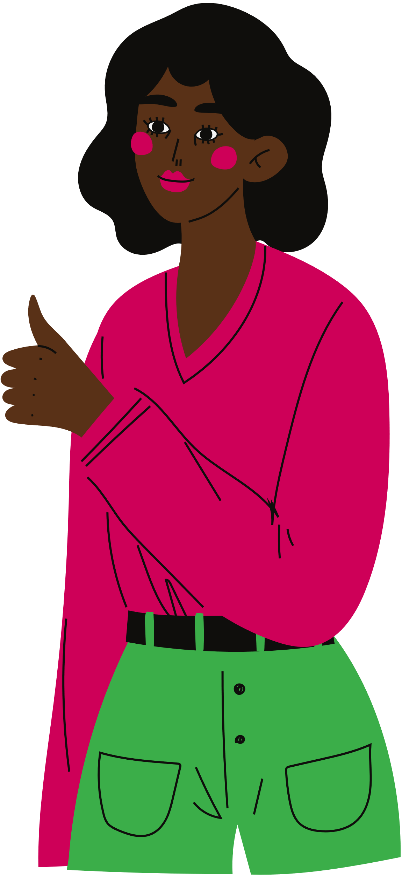
Social Media Engagement
Meet young people where they’re at: social media!
#
FREE YOUR FEELS
08

Slide 8
Using Data:
Return to your goals and track your impact
Impressions
Audience
Direct Sessions
Site Sessions
51% Increase
53% Increase
108% Increase
73% Increase
FREE YOUR FEELS
09

Slide 9
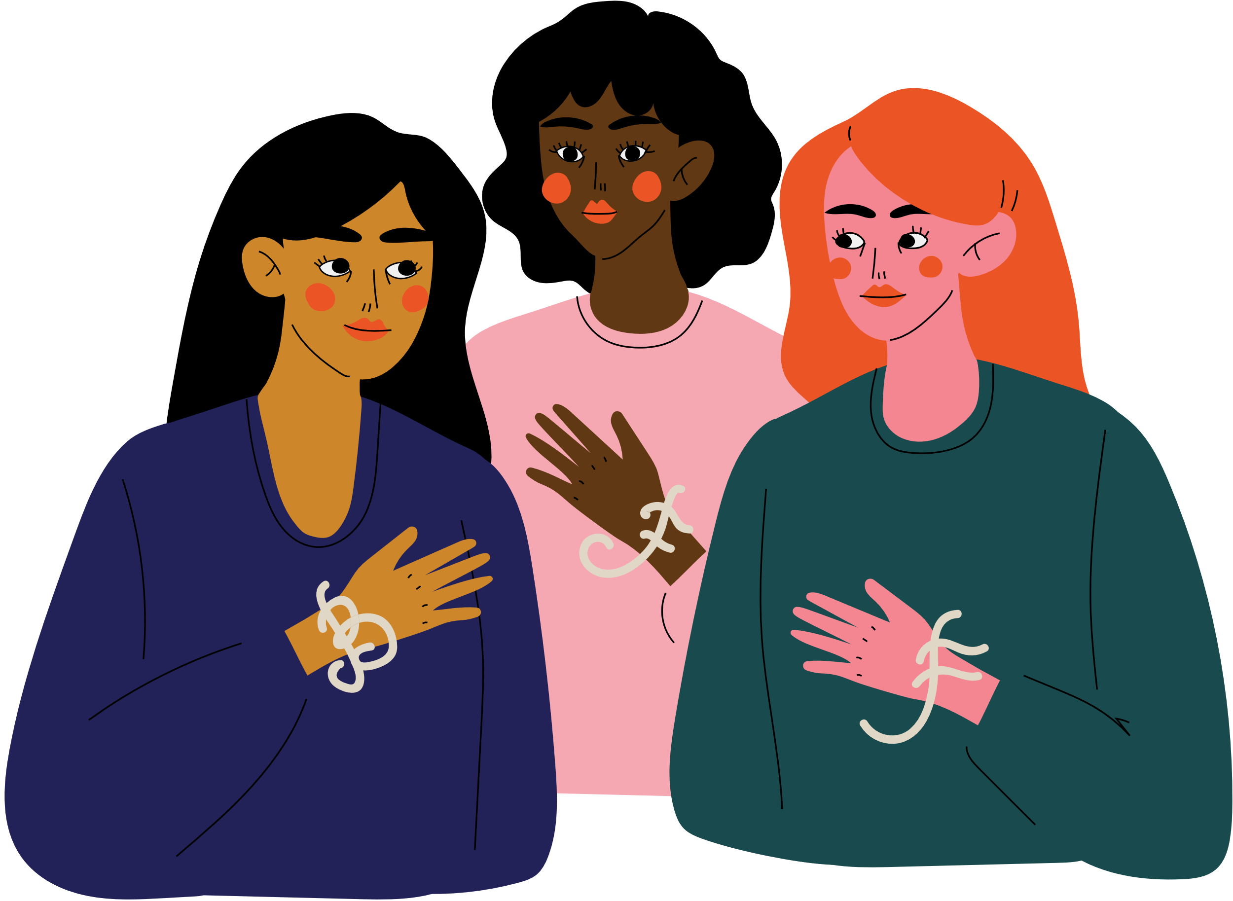
Free Your Feels Champions
Normalizing the conversation around mental health.
Bringing the campaign to others in your community.
Prioritizing youth voice and encouraging adult support.
FREE YOUR FEELS
10

Slide 10
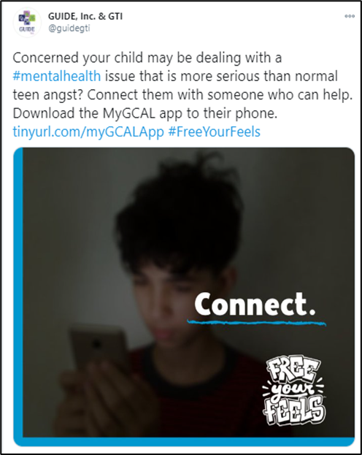
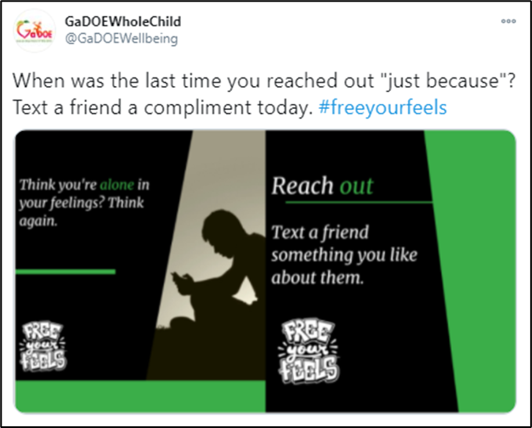
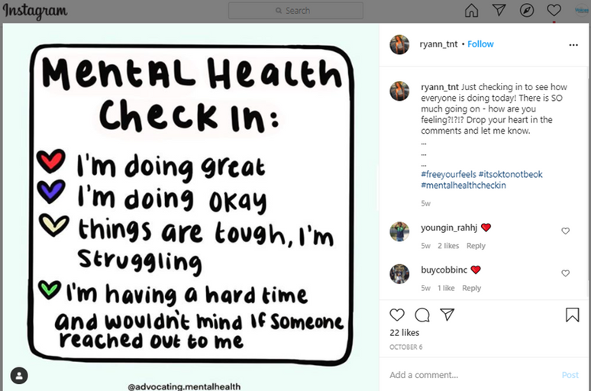
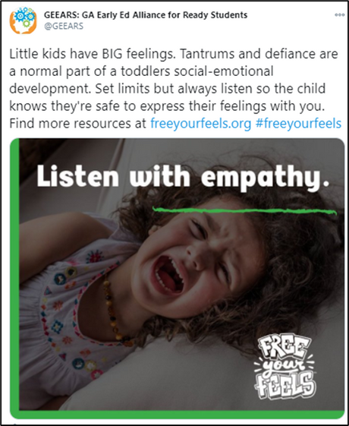
Champions in Action
GaDOE Office of Whole Child Supports
GUIDE, Inc.
Teen Post
GEEARS
FREE YOUR FEELS
11

Slide 11
State Engagement
FYF Toolkits - Campaign posts content to engage those middle and high school age, their caregivers, families and those who work with youth.
FYF Website - Student, educator/professional, and parent/caregiver resources
Statewide Collaboration - Strengthening the System of Care
FREE YOUR FEELS
12
Notes:
The key thing: to make it super easy for anyone and everyone across the state to engage.
We even thought through ease when making our toolkits. We made them so you can click and share our already created content directly to social media, and download to post in classrooms, childcare, schools, pediatrician offices.
And we know this method works because in the first month, over 1000 people engaged with the toolkit (downloads, clicks, etc)!

Slide 12
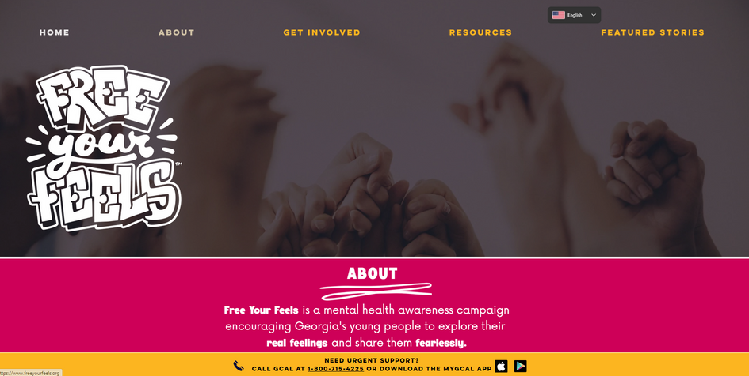
Website
www. freeyourfeels.org
A one-stop-shop website to connect youth and adults to existing resources.
FREE YOUR FEELS
13

Slide 13
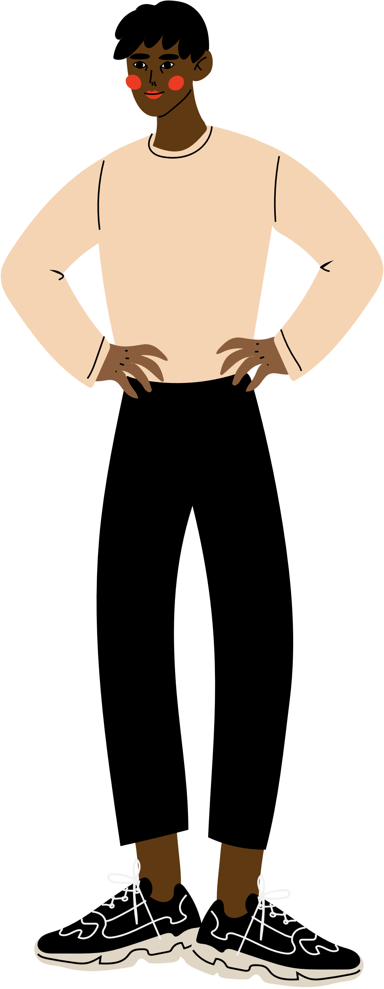
What's Next?
DOWNLOAD OUR BLUEPRINT
FIND RESOURCES RELEVANT TO YOUR COMMUNTIY
IMPLEMENT FREE YOUR FEELS
FREE YOUR FEELS
14

Slide 14
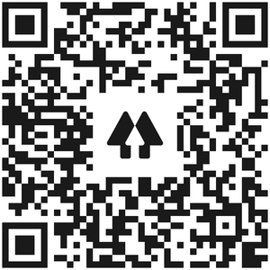
Call to Action
VISIT OUR WEBSITE
WWW.FREEYOURFEELS.ORG
FOLLOW US ON SOCIAL MEDIA
SHARE OUR RESOURCES ON YOUR PLATFORMS
IMPLEMENT FYF IN YOUR COMMUNITY!
FREE YOUR FEELS
15
Notes:
Yes, we still need your help to help us bring more awareness to the Free Your Feels campaign. Our ask is simple! We simply ask that you visit our website, follow our social media handles, and share our resources on your platforms. With your help, together we are increasing the chances of a someone in need of mental health resources receiving them. Together, we can make sure Georgia's youth and their caregivers are able to do exactly what our campaign is all about, which is free their feels!

Slide 15
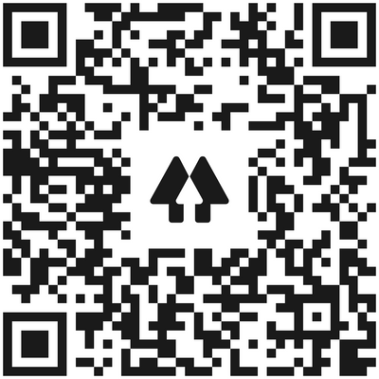
Questions?
@FreeYourFeelsGA
@FreeYourFeelsGA
@FreeYourFeelsGA

